Slide 1
Chapter 17: Database System Architectures

Slide 2
Chapter 17: Database System Architectures
Centralized and Client-Server Systems
Server System Architectures
Parallel Systems
Distributed Systems
Network Types

Slide 3
Parallel Systems
Parallel database systems consist of multiple processors and multiple disks connected by a fast interconnection network.
A coarse-grain parallel machine consists of a small number of powerful processors
A massively parallel or fine grain parallel machine utilizes thousands of smaller processors.
Two main performance measures:
  throughput --- the number of tasks that can be completed in a given time interval
  response time --- the amount of time it takes to complete a single task from the time it is submitted

Slide 4
Speed-Up and Scale-Up
Speedup: a fixed-sized problem executing on a small system is given to a system which is N-times larger.
  Measured by:
  speedup = small system elapsed time
  large system elapsed time
  Speedup is linear if equation equals N.
Scaleup: increase the size of both the problem and the system
  N-times larger system used to perform N-times larger job
  Measured by:
  scaleup = small system small problem elapsed time
  big system big problem elapsed time
  Scale up is linear if equation equals 1.

Slide 5
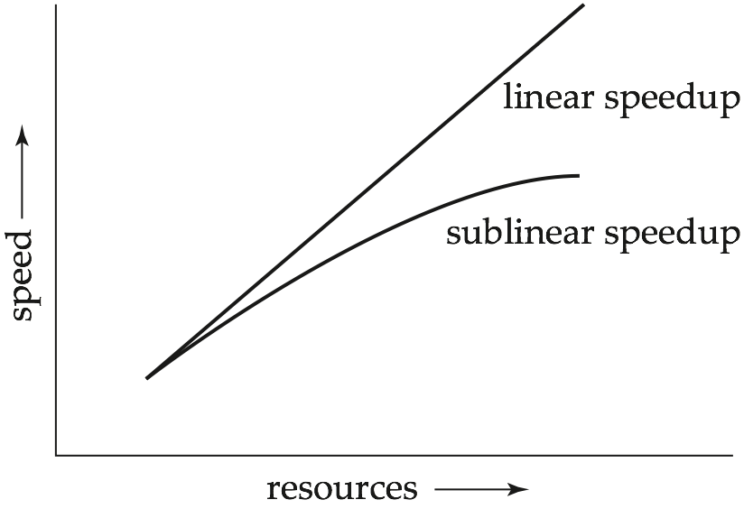
Speedup

Slide 6
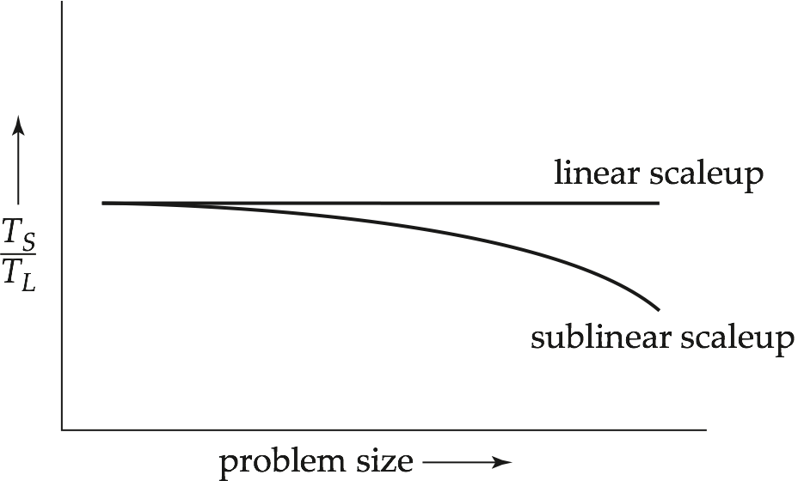
Scaleup

Slide 7
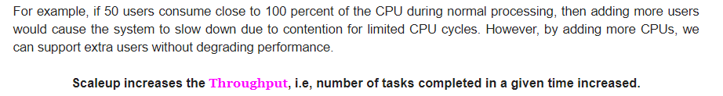

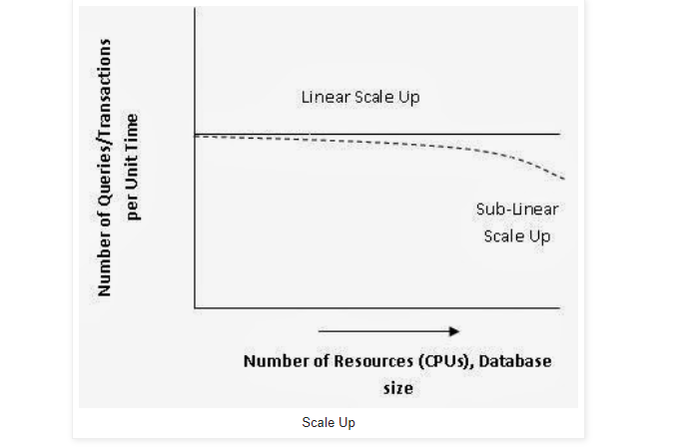

Slide 8
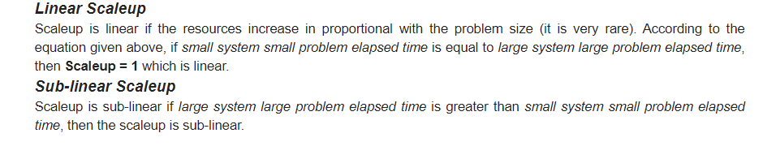

Slide 9
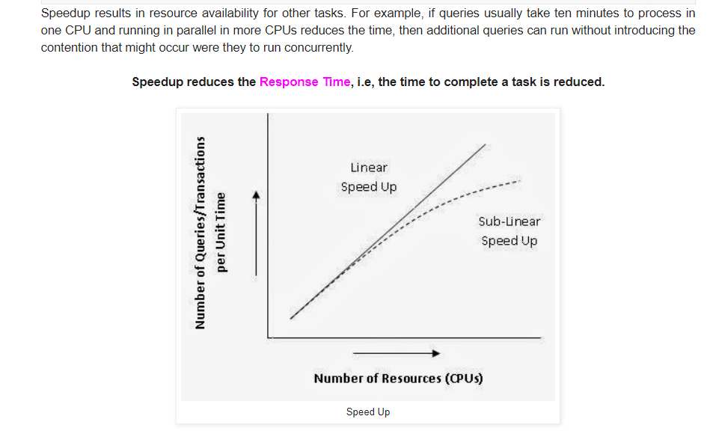

Slide 10
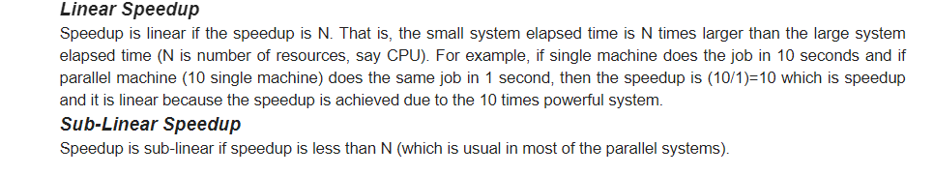

Slide 11

Batch and Transaction Scaleup
Batch scaleup:
  A single large job; typical of most decision support queries and scientific simulation.
  Use an N-times larger computer on N-times larger problem.
Transaction scaleup:
  Numerous small queries submitted by independent users to a shared database; typical transaction processing and timesharing systems.
  N-times as many users submitting requests (hence, N-times as many requests) to an N-times larger database, on an N-times larger computer.
  Well-suited to parallel execution.

Slide 12

Factors Limiting Speedup and Scaleup
Speedup and scaleup are often sublinear due to:
Startup costs: Cost of starting up multiple processes may dominate computation time, if the degree of parallelism is high.
Interference: Processes accessing shared resources (e.g., system bus, disks, or locks) compete with each other, thus spending time waiting on other processes, rather than performing useful work.
Skew: Increasing the degree of parallelism increases the variance in service times of parallely executing tasks. Overall execution time determined by slowest of parallely executing tasks.

Slide 13

Parallel Database Architectures
Shared memory -- processors share a common memory
Shared disk -- processors share a common disk
Shared nothing -- processors share neither a common memory nor common disk
Hierarchical -- hybrid of the above architectures

Slide 14
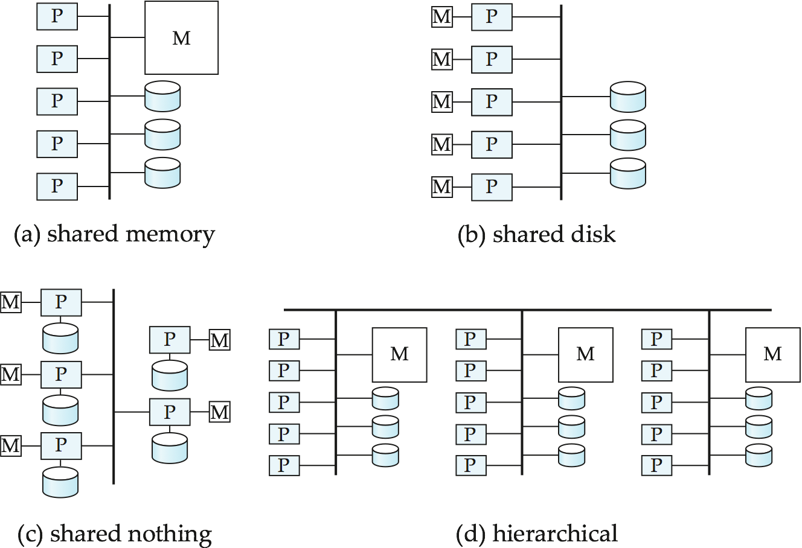

Parallel Database Architectures

Slide 15
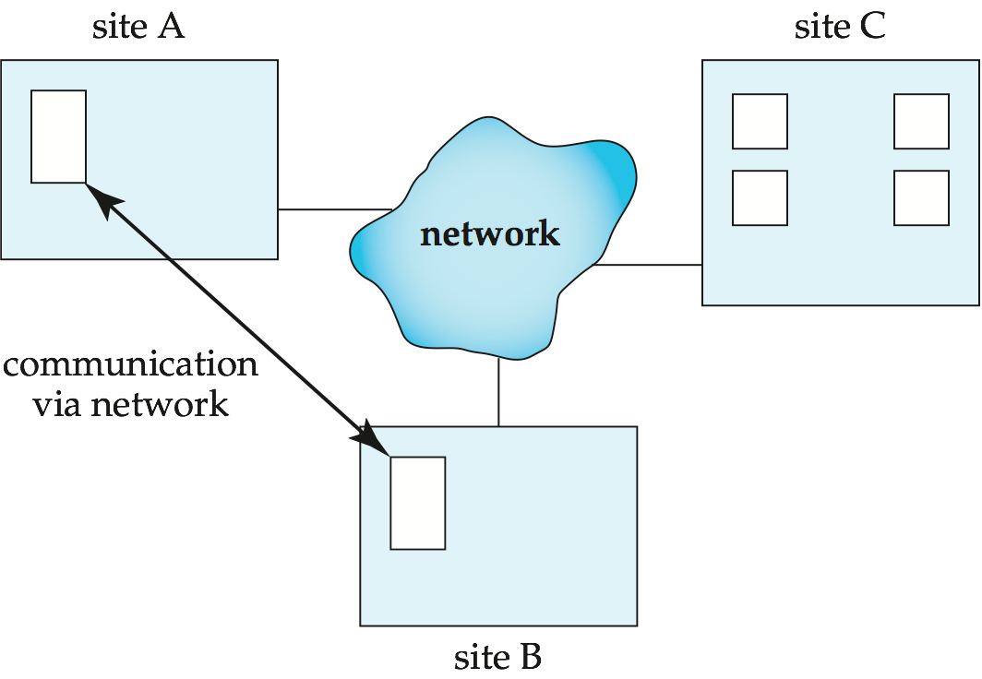
Distributed Systems
Data spread over multiple machines (also referred to as sites or nodes).
Network interconnects the machines
Data shared by users on multiple machines

Slide 16

Distributed Databases
Homogeneous distributed databases
  Same software/schema on all sites, data may be partitioned among sites
  Goal: provide a view of a single database, hiding details of distribution
Heterogeneous distributed databases
  Different software/schema on different sites
  Goal: integrate existing databases to provide useful functionality
Differentiate between local and global transactions
  A local transaction accesses data in the single site at which the transaction was initiated.
  A global transaction either accesses data in a site different from the one at which the transaction was initiated or accesses data in several different sites.

Slide 17
Trade-offs in Distributed Systems
Sharing data – users at one site able to access the data residing at some other sites.
Autonomy – each site is able to retain a degree of control over data stored locally.
Higher system availability through redundancy — data can be replicated at remote sites, and system can function even if a site fails.
Disadvantage: added complexity required to ensure proper coordination among sites.
  Software development cost.
  Greater potential for bugs.
  Increased processing overhead.

Slide 18
Implementation Issues for Distributed Databases
Atomicity needed even for transactions that update data at multiple sites
The two-phase commit protocol (2PC) is used to ensure atomicity
  Basic idea: each site executes transaction until just before commit, and the leaves final decision to a coordinator
  Each site must follow decision of coordinator, even if there is a failure while waiting for coordinators decision
2PC is not always appropriate: other transaction models based on persistent messaging, and workflows, are also used
Distributed concurrency control (and deadlock detection) required
Data items may be replicated to improve data availability

Slide 19
End of Chapter 17

